Slide 1




QA Automation Workshop
02/11/2023
Enda Brody

Slide 2


Agenda
Introductions
Set Up
Automation Pros and Cons, Paid vs Open-Source tools/frameworks.
Automation what are the different kinds the Testing cupcake . 🧁
Coding Challenges 🦾
Functional tests
Visual regression tests
Api calls and tests through the Web testing tool
Pipelines
Microsoft Azure
Coding with Chat GTP
To find out more additional resources Automation Testing 📚
Notes:
set up 10 -15
Slides – 5 mins
Code – Start 11:25 -11:30 am – 12:20
Break

Slide 3
Set Up
endaVersion1/QaAutomation: Qa repo with all code project samples from Workshop november 2023 (github.com)

Slide 4
Automation Pros and Cons, Paid vs Open-Source tools/frameworks.
Pros
Faster feedback loop
Help build coverage and confidence with regression Testing.
Cons
Initial set-up cost
Maintenance overhead
Examples of Paid Tools: ApiTools, Smart Bear, TestRigior
Paid
Setup is faster with additional support
Faster delivery of testing and easier maintenance (in some cases)
Pay as a service cost
Limiting the tester’s knowledge and capabilities, paid tools are not always as flexible.
Open
Low Cost
High Flexibility
Knowledge Gaps
Tool support

Slide 5

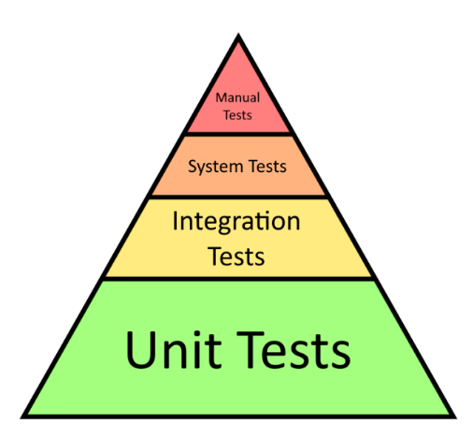
Automation what are the different kinds Testing cupcake . 🧁
UI functional End 2 end test
Api tests
Performance Tests (non-functional)
Visual Regression
Browser and Device tests(non-functioning)
Unit tests
Visual Regression
Performance Regression
UI End2end Functioning Tests
Api Tests
Mocked API Tests
Unit Tests

Slide 6


Selenium Web Driver coding Challenges
CODING TIME !!!!

Slide 7
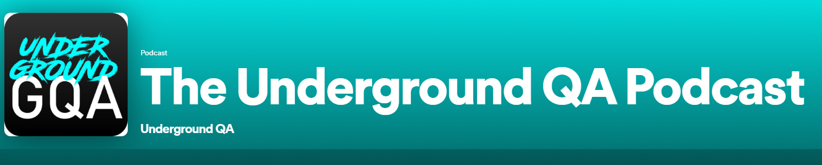

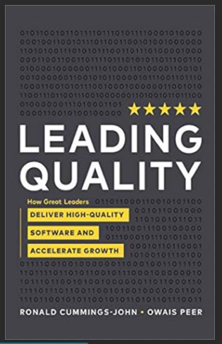
To find out more additional resources Automation Testing
Links
https://www.guru99.com
https://applitools.com/tutorials/quickstart/web/selenium/java/junit
https://playwright.dev/docs/test-assertions
https://docs.cypress.io/api/table-of-contents
https://www.selenium.dev/documentation/webdriver/elements/locators/
Podcasts:
TestGuild Automation Joe Colantonio
The Underground QA podcast
Books: Leading Quality

